Slide 1


Probability 1
Number of favourable outcome
Probability
$$=$$
Total number of possible outcome
Example
Probability of getting tail by tossing a coin
Getting tail only
1
$$=$$
2
Getting tail or head

Slide 2
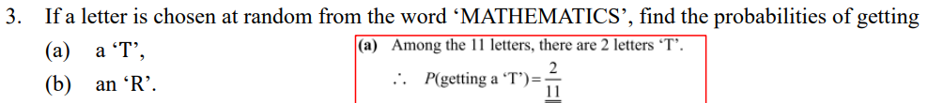






2 ‘T’ in MATHEMATICS
2
(a)
P(getting a T)
$$=$$
11
11 letter in MATHEMATICS
0 ‘R’ in MATHEMATICS
0
(b)
$$=$$
P(getting an R)
11
11 letter in MATHEMATICS

Slide 3
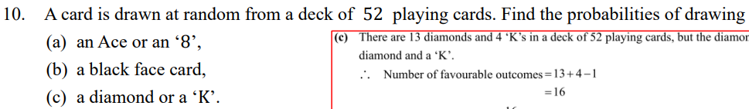

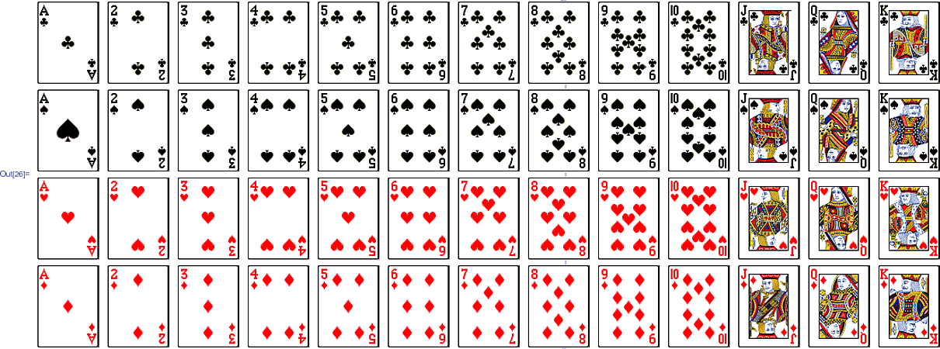
















(a)
P(an ace or an ‘8’)
4
$$+$$
4
$$=$$
52
2
$$=$$
13
(b)
P(a black face card)
6
$$=$$
52
4
$$=$$
13
(c)
P(a diamond or a ‘K’)
13
$$+$$
4
$$−$$
1
4
$$=$$
$$=$$
52
13

Slide 4










Number of female stuff
Probability
$$=$$
Total number of stuff
6
n
$$=$$
$$+$$
17
n
33
6n
$$+$$
198
$$=$$
17n
n
$$=$$
18

Slide 5
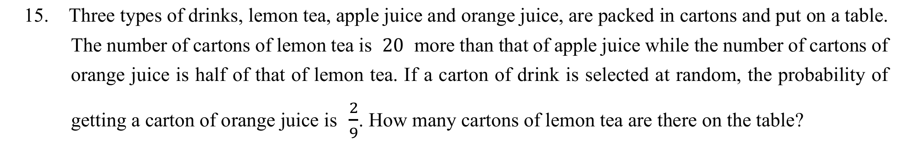
























Let n be the number of cartons of lemon tea.
Then the number of cartons of apple juice is
(
n
$$−$$
)
20
and the number of cartons of orange juice is
1
n
2
$$=$$
$$+$$
(
n
$$−$$
)
$$+$$
1
5
Total number of cartons of drinks
n
20
n
$$=$$
$$−$$
n
20
2
2
$$∵$$
Probability of getting a carton of orange juice
$$=$$
2
9
1
n
2
2
$$∴$$
$$=$$
5
$$−$$
9
n
20
2
9
n
$$=$$
n
$$−$$
10
80
n
2
$$=$$
$$=$$
5
n
$$−$$
40
9
n
80

Slide 6
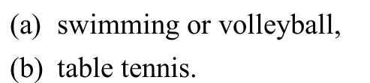
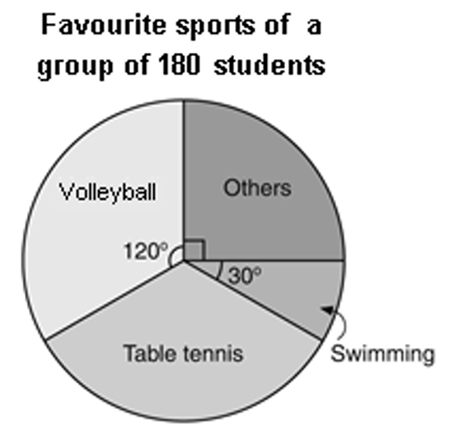





















(a)
Sum of angles at the centre of the sectors representing ‘swimming’ and ‘volleyball’
o
o
o
$$=$$
30
$$+$$
120
$$=$$
150
o
$$∴$$
150
P(swimming or volleyball)
$$=$$
o
360
5
$$=$$
12
(b)
Angle at the centre of the sector representing ‘table tennis’
o
o
o
o
o
$$=$$
360
$$−$$
120
$$−$$
90
$$−$$
30
$$=$$
120
o
120
$$∴$$
P(table tennis)
$$=$$
o
360
$$=$$
1
3

Slide 7
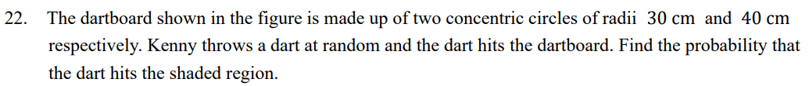
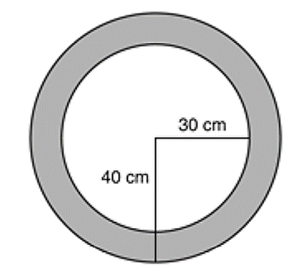





















2
$$×$$
(
Area of the dartboard
40)
$$=$$
$$π$$
$$=$$
1600$π$
2
cm
2
2
$$−$$
$$×$$
(
$$×$$
(
30)
Area of the shaded region
$$=$$
$$π$$
40)
$$π$$
$$=$$
700$π$
2
cm
700$π$
$$=$$
P(hits the shaded region)
1600$π$
7
$$=$$
16

Slide 8
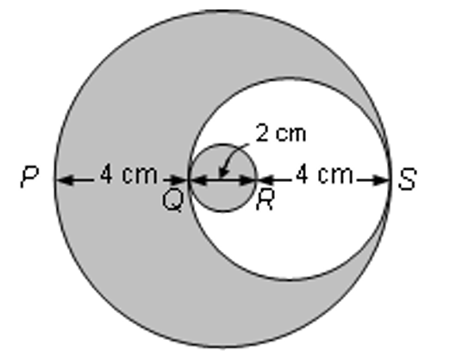






































Let circles A, B and C denote the largest circle, the second largest circle and the smallest circle respectively.
$$+$$
$$+$$
2
4
2
4
Area of circle A
$$=$$
$$π$$
$$×$$
2
$$=$$
$$π$$
2
25
cm
$$+$$
2
$$π$$
$$×$$
4
2
Area of circle B
$$=$$
2
$$π$$
$$−$$
$$π$$
$$+$$
$$π$$
2
(
9
25
)
cm
$$=$$
$$π$$
2
$$∴$$
P(hits the shaded region)
$$=$$
9
cm
25
2
2
$$π$$
cm
2
Area of circle C
$$=$$
$$π$$
$$×$$
$$π$$
17
2
$$=$$
$$π$$
2
25
$$=$$
$$π$$
cm
17
$$=$$
25

Slide 9



Probability 2
Tree diagram
List out all the possible outcomes
Example
1st Toss
2nd Toss
Possible outcome
Head
HH
Head
Tail
HT
Head
TH
Tail
Tail
TT
2
1
$$=$$
$$=$$
P(getting exactly 1 head and 1 tail)
4
2

Slide 10
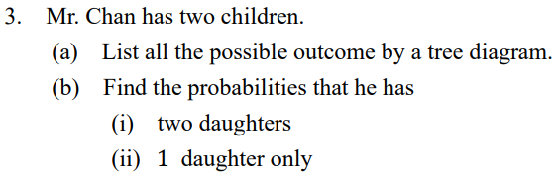







1
(bi)
$$=$$
(a)
Child 1
Child 2
Possible outcome
P(two daughters)
4
2
M
MM
(bii)
P(one daughter only)
$$=$$
4
M
1
F
MF
$$=$$
2
M
FM
F
F
FF

Slide 11

Tabulation
List out all the possible outcomes
Example
First toss
H
T
Second toss
H
HH
HT
T
TH
TT
Possible outcome
$$=$$
HH, HT, TH, TT

Slide 12
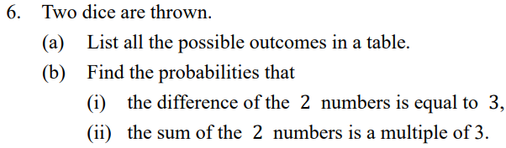








(a)
First dice
(bi)
P(difference is equal to 3)
1
2
3
4
5
6
Second dice
6
$$=$$
1
(1,1)
(1,2)
(1,3)
(1,4)
(1,5)
(1,6)
36
2
(2,1)
(2,2)
(2,3)
(2,4)
(2,5)
(2,6)
1
$$=$$
6
3
(3,1)
(3,2)
(3,3)
(3,4)
(3,5)
(3,6)
(bii)
P(sum is a multiple of 3)
4
(4,1)
(4,2)
(4,3)
(4,4)
(4,5)
(4,6)
12
$$=$$
5
(5,1)
(5,2)
(5,3)
(5,4)
(5,5)
(5,6)
36
6
(6,1)
(6,2)
(6,3)
(6,4)
(6,5)
(6,6)
1
$$=$$
3

Slide 13
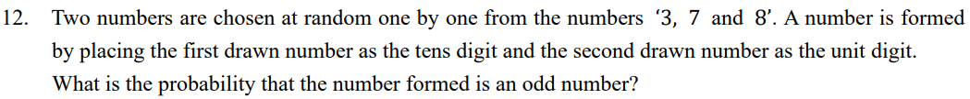






Tens digit
Unit digit
Possible outcome
P(Odd number)
4
7
37
$$=$$
6
3
8
38
2
3
73
$$=$$
3
7
8
78
3
83
8
7
87

Slide 14
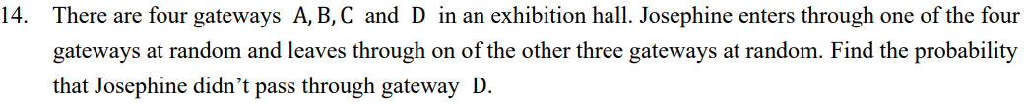






Enter
A
B
C
D
Leave
(
(
(
A
B,A)
C,A)
D,A)
B
(
(
A,B)
C,B)
(
D,B)
C
(
(
A,C)
B,C)
(
D,C)
D
(
(
(
A,D)
B,D)
C,D)
P(didn’t pass through gateway B)
6
$$=$$
12
1
$$=$$
2

Slide 15
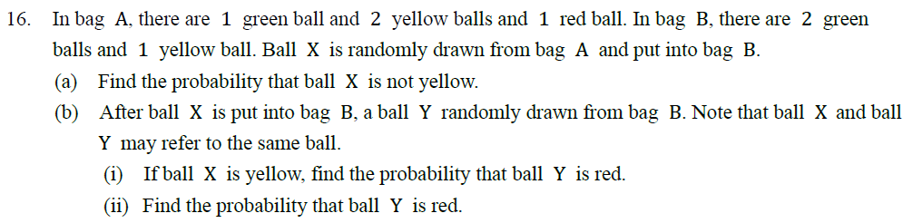














Ball X
Ball Y
Green
Green
Green
Green
$$∴$$
The required probability
(a)
P(ball X is not yellow)
(bii)
Yellow
2
Green
1
$$=$$
$$=$$
4
Green
16
Yellow (1)
Yellow
1
$$=$$
Yellow
2
Green
(bi)
P(ball Y is red)
Green
Yellow (2)
Yellow
0
Yellow
$$=$$
Green
4
Green
$$=$$
Red
Yellow
0
Red

Slide 16
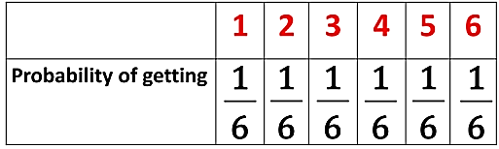















Probability 3
Expected value
$$=$$
Probability of the event
$$×$$
Value of the event
Example
1
1
1
1
1
1
Expected value
$$=$$
$$×$$
1
$$+$$
$$×$$
2
$$+$$
$$×$$
3
$$+$$
$$×$$
4
$$+$$
$$×$$
5
$$+$$
$$×$$
6
6
6
6
6
6
6
$$=$$
3.5

Slide 17
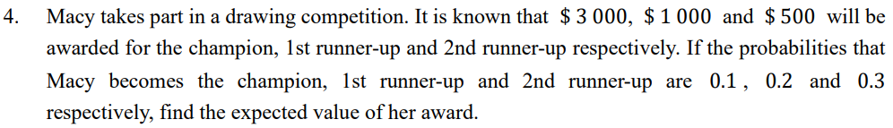














Expected value
$$=$$
0.1
$$×$$
3000
$$+$$
0.2
$$×$$
1000
$$+$$
0.3
$$×$$
500
$$=$$
$650

Slide 18
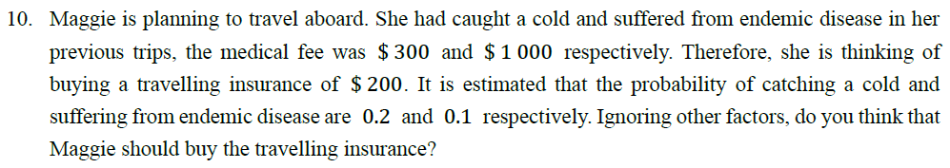









Expected medical fee
$$=$$
$(
300
$$×$$
0.2
$$+$$
1000
$$×$$
0.1
)
$$=$$
$160
Since the expected medical fee is less than the insurance premium, Maggie should not buy the travelling insurance

Slide 19
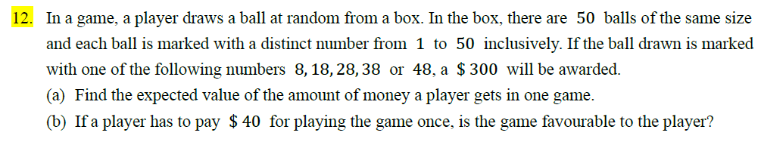

















5
1
(b)
$$∵$$
Expected value of the amount of money a plater get ($30) is smaller than the cost of playing the game ($40)
(a)
P($300)
$$=$$
$$=$$
50
10
50$−\text{5}$
9
P($0)
$$=$$
$$=$$
50
10
$$∴$$
The game is not favourable to the player
Expected value of the amount of money
$$=$$
1
9
$
300
$$×$$
$$+$$
0
$$×$$
10
10
$$=$$
$30

Slide 20
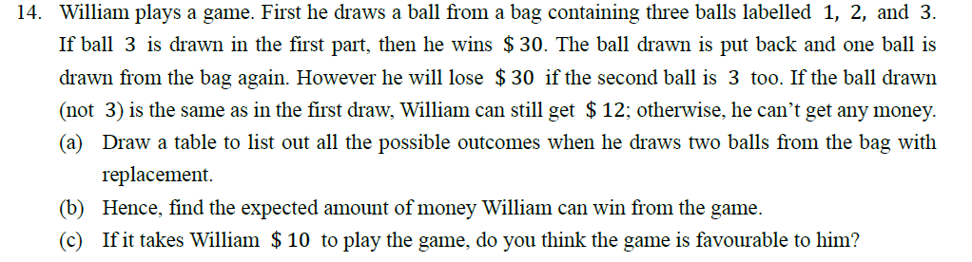






















1
$$∵$$
(b)
P(1, 1)
(c)
6
$$<$$
10
(a)
$$=$$
2nd outcome
9
1
$$∴$$
Not favourable
P(2, 2)
$$=$$
1
2
3
9
2
$$=$$
P(3, 1/ 3, 2)
1st outcome
1
1, 1
1, 2
1, 3
9
1
P(3, 3)
2
2, 1
2, 2
2, 3
$$=$$
9
3
3, 1
3, 2
3, 3
Expected value
1
1
2
1
$$=$$
$$×$$
12
$$+$$
$$×$$
12
$$+$$
$$×$$
30
$$+$$
$$×$$
($−$30)
9
9
9
9
$$=$$
$6

Slide 21






























Expected value of multiple event
=
Probability of first event
$$×$$
Marks of first events
$$+…+$$
Probability of last event
$$×$$
Marks of last events
Example
Expected value of rolling dice twice
1
1
1
1
1
1
1
1
1
$$=$$
$$×$$
1
$$+$$
$$×$$
2
$$+$$
$$×$$
3
$$+$$
$$×$$
4
$$+$$
$$×$$
5
$$+$$
$$×$$
6
$$+$$
$$×$$
1
$$+$$
$$×$$
2
$$+$$
$$×$$
3
$$+$$
6
6
6
6
6
6
6
6
6
1
1
1
$$×$$
4
$$+$$
$$×$$
5
$$+$$
$$×$$
6
6
6
6
$$=$$
3.5
$$+$$
3.5
$$=$$
7

Slide 22















Expected total mark after the two tosses
$$−$$
$$+$$
$$×$$
$$+$$
$$×$$
$$−$$
20)
$$=$$
0.5
$$×$$
50
$$+$$
0.5
$$×$$
(
20)
0.5
50
0.5
(
$$=$$
15
$$+$$
15
$$=$$
30

Slide 23
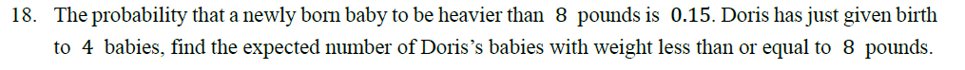








P(less than or equal to 8 pounds)
$$=$$
1
$$−$$
0.15
$$=$$
0.85
Expected number
$$=$$
4
$$×$$
0.85
$$=$$
3.4

Slide 24
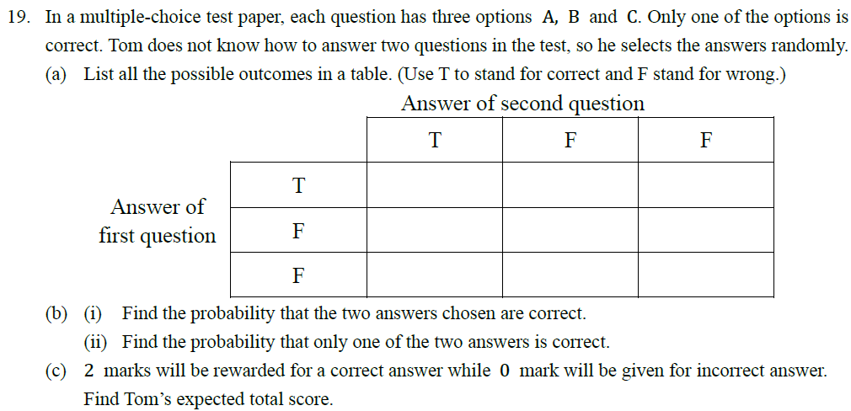


















T T
T F
T F
F T
F F
F F
F T
F F
F F
(c)
Tom’s expected total score
1
1
4
(bi)
P(Two answers chosen are correct)
$$=$$
$$=$$
4
$$×$$
$$+$$
2
$$×$$
$$=$$
1.33
9
9
9
or
4
(bii)
$$=$$
1
P(Only one of the answers is correct)
$$×$$
$$×$$
2
$$=$$
1.33
9
2
3

Slide 25
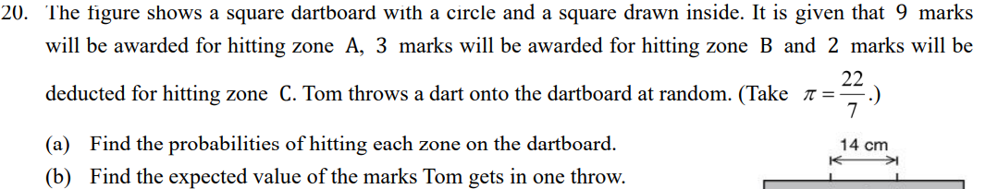
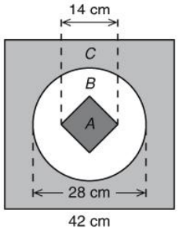



































$$=$$
2
$$=$$
1764
2
7
Area of the dart board
(
cm
(a)
42)
$$∵$$
Zone A is a square which can be decomposed into two identical triangles with height 7 cm and base 14 cm
14
1
2
$$=$$
$$×$$
$$×$$
14
$$×$$
7
$$=$$
98
cm
Area of zone A
2
1148
41
2
P(hitting zone C)
$$=$$
$$=$$
$$=$$
$$π$$
2
$$=$$
2
1764
63
$$×$$
(
$$−$$
518
cm
Area of zone B
14)
98
$$=$$
1764
$$−$$
518
$$−$$
98
$$=$$
1148
2
Area of zone C
cm
(b)
Expected value
98
1
P(hitting zone A)
$$=$$
1
37
41
$$=$$
$$=$$
$$×$$
$$+$$
$$×$$
$$+$$
$$×$$
$$−$$
2)
1764
18
9
3
(
18
126
63
518
37
P(hitting zone B)
$$=$$
$$=$$
5
1764
126
$$=$$
63

